Slide 1
Gestalt in the Wild COMP2044: HCI Workshop2
Yuyang Zhang(20514470)
scyyz26@Nottingham.edu.cn

Slide 2
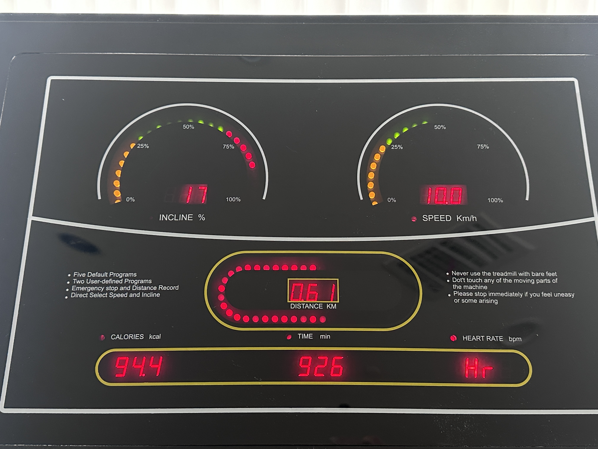
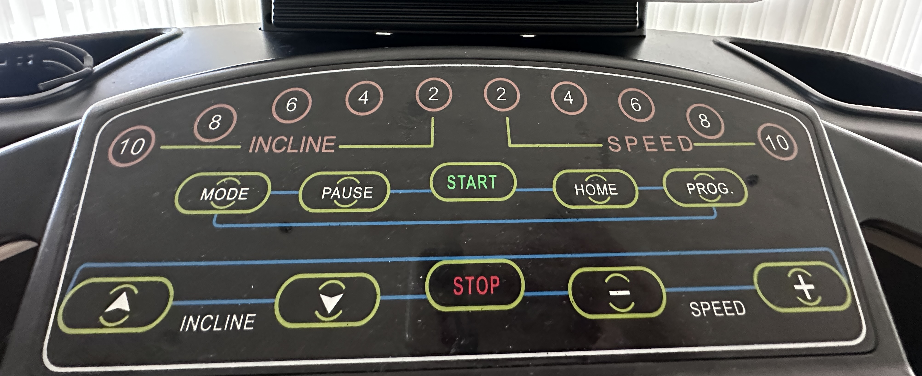
Treadmill Control Panel Gestalt Principle
Proximity
Similarity
Closure
Symmetry
Image: A photo of treadmill control and operation interface of the gym, displaying key workout data such as the incline, speed, distance, time, calories and heart rate.

Slide 3
Treadmill Control Panel Gestalt Principle
Proximity
Using negative space to separate functions.

Slide 4
Treadmill Control Panel Gestalt Principle
Similarity
Similar design and color coding for easy recognition.

Slide 5
Treadmill Control Panel Gestalt Principle
Closure
Using incomplete shapes to create a sense of wholeness.

Slide 6
Treadmill Control Panel Gestalt Principle
Symmetry
Symmetrical design for visual balance and intuitive navigation.

Slide 7
Treadmill Control Panel Gestalt Principle
Proximity
Similarity
Closure
Symmetry
Image: A photo of treadmill control and operation interface of the gym, displaying key workout data such as the incline, speed, distance, time, calories and heart rate.

